Slide 1
KNN model
K-nearest neighbour is one of the simplest machine learning algorithms based on supervised learning technique.
K-nn algorithm assumes the similarity between the new case/data and available cases and put the new case into the category that is most similar to the available categories.
K-nn algorithm stores all the available data and classifies a new data point based on the similarity. This means when new data appears then it can be easily classified into a well suite category by using K- NN algorithm.
K-nn algorithm can be used for regression as well as for classification but mostly it is used for the classification problems.
K-nn is a non-parametric algorithm, which means it does not make any assumption on underlying data.
It is also called a lazy learner algorithm because it does not learn from the training set immediately instead it stores the dataset and at the time of classification, it performs an action on the dataset.
Knn algorithm at the training phase just stores the dataset and when it gets new data, then it classifies that data into a category that is much similar to the new data.

Slide 2
Example: Suppose, we have an image of a creature that looks similar to cat and dog, but we want to know either it is a cat or dog. So for this identification, we can use the KNN algorithm, as it works on a similarity measure. Our KNN model will find the similar features of the new data set to the cats and dogs images and based on the most similar features it will put it in either cat or dog category.

Slide 3
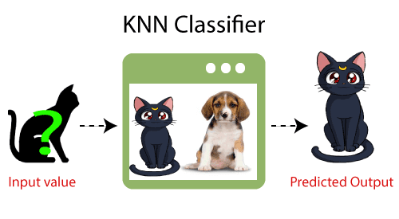

Slide 4
What is k in KNN algorithm
'k' in KNN is a parameter that refers to the number of nearest neighbours to include in the majority of the voting process. ... Let's say k = 5 and the new data point is classified by the majority of votes from its five neighbours and the new point would be classified as red since four out of five neighbours are red.

Slide 5
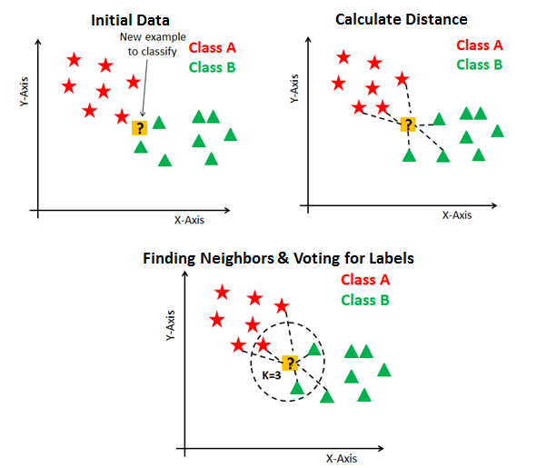

Slide 6
What are the steps in KNN
Step-1: Select the number K of the neighbors
Step-2: Calculate the Euclidean distance of K number of neighbors
Step-3: Take the K nearest neighbors as per the calculated Euclidean distance.
Step-4: Among these k neighbors, count the number of the data points in each category.
Step-5: Assign the new data points to that category for which the number of the neighbor is maximum.
Step-6: Our model is ready.

Slide 7
How distance can be calculated
Distance Metrics
The distance metric is the effective hyper-parameter through which we measure the distance between data feature values and new test inputs.

Slide 8
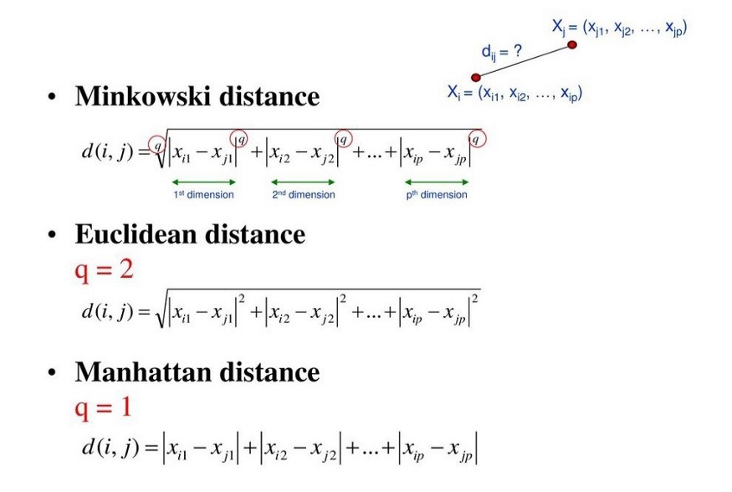

Slide 9
Usually, we use the Euclidean approach, which is the most widely used distance measure to calculate the distance between test samples and trained data values. We measure the distance along a straight line from point (x1, y1) to point (x2, y2).

Slide 10
